Slide 1
GPS Jamming Methods
GPS Jammer Detection – Capstone Schwartz
Lorenzen Devin
Noh Hanjae
Sayers Edward
Wilson Ben
Wong Chi

Slide 2
GPS Receivers
Center Frequency L1 (1525.42MHz)
Protected Bandwidth 20.46 MHz
Precision code (P) Code ≈ -133 dBm
Course Acquisition (C/A) Code ≈ -130 dBm

Slide 3
Todays Jammers
Continues Wave Jamming
Pulse Jamming
Chirp Jamming
Harmonic Jamming
Unintentional

Slide 4
Jammer Similarities
Noise in the L1 band (1575.42MHz ± 10.23 MHz)
Theoretical jammer power ≥ -65 dBm

Slide 5
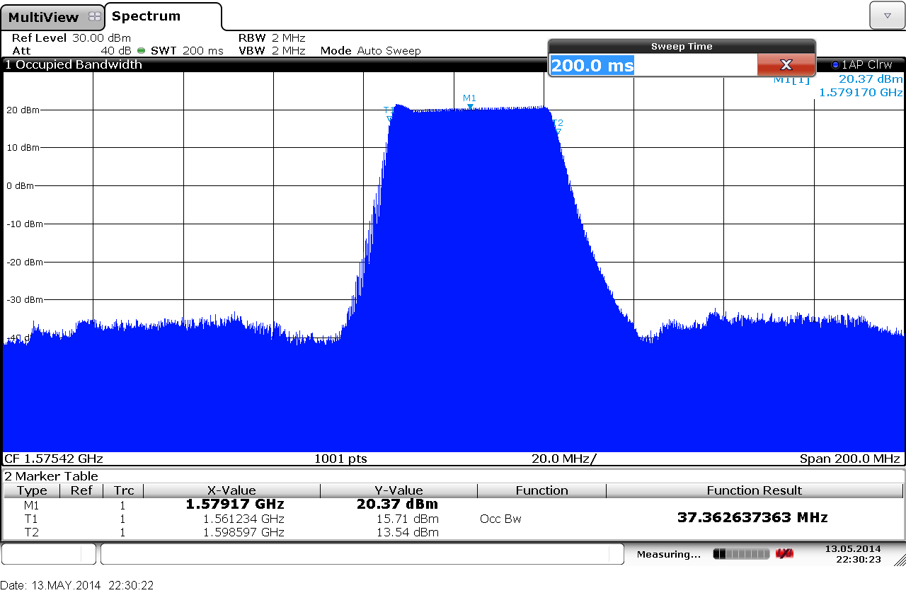
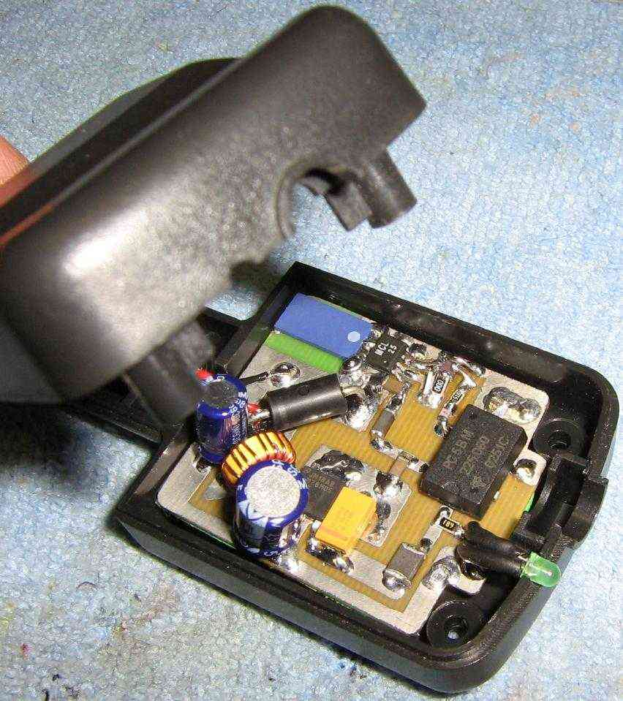
Continues Wave Jamming (CW/NB/WB)
Oscillator within the L1 protected band.
Bandwidth grater than 30 KHz

Slide 6
Pulse Jamming (CW/NB/WB)
Pulse repetition frequency (PRF) 1Hz to 20kHz
Duty cycle 10% to 90%

Slide 7
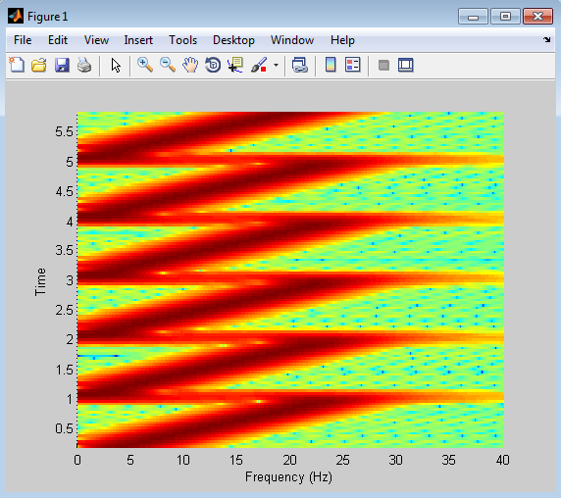
Chirp Jamming

Slide 8
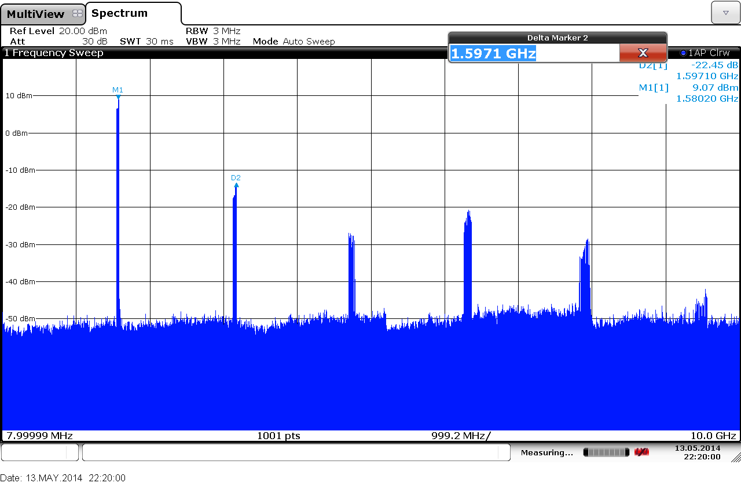
Harmonic Jamming

Slide 9
Unintentional Jamming
Poor Hardware that unintentionally transmits RF signals
Under filtered RF transmitters

